Slide 1

Namma Yatri

Slide 2
Problem Statement
Drivers come from all ages. It is generally evident that drivers who are not millennials are not very technologically savvy. Despite the advances in technology, the apps and features cannot create value unless they are widely adopted by the drivers. Identify ways to digitally enable drivers, so that they can earn on par with fellow drivers.
Objective
Analyze ride-hailing patterns to identify key inefficiencies.
Optimize fare pricing strategies using data insights.
Improve driver allocation based on demand-supply trends.
Increase digital payment adoption among customers.
Understanding and Overcoming Language Barriers

Slide 3
Executive Summary
Namma Yatri is transforming urban mobility through a driver-first, tech-enabled platform.
Key challenge: non-millennial drivers face tech adoption barriers.
Strategic focus: improve digital adoption, retention, and earnings.
This presentation highlights insights, metrics, and business-level recommendations.

Slide 4
Key Challenges
Low digital literacy among older drivers
Resistance to app usage and feature adoption
Inadequate support systems and training
Language barriers affecting engagement
Unmonitored performance and training efficacy

Slide 5
Strategic Opportunities
Leverage app-based training and gamification for increased adoption
Implement personalized support systems for drivers
Optimize app interfaces for accessibility
Monitor driver progress and provide data-backed incentives

Slide 6
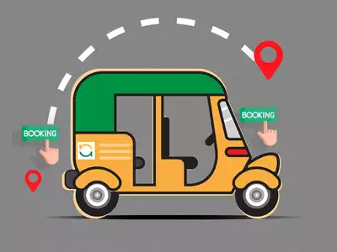
Business Insights
Drivers using training programs show 15-20% higher engagement
Personalized support correlates with a 10% rise in earnings
Gamified platforms improve app interaction by over 30%
Drivers prefer content in local languages and video format

Slide 7
Strategic Recommendations
1. Scale digital training programs across cities
2. Offer multilingual, video-first learning content
3. Deploy a support hotline for app-related issues
4. Introduce driver incentives linked to feature usage
5. Measure KPIs via app-based analytics dashboards

Slide 8
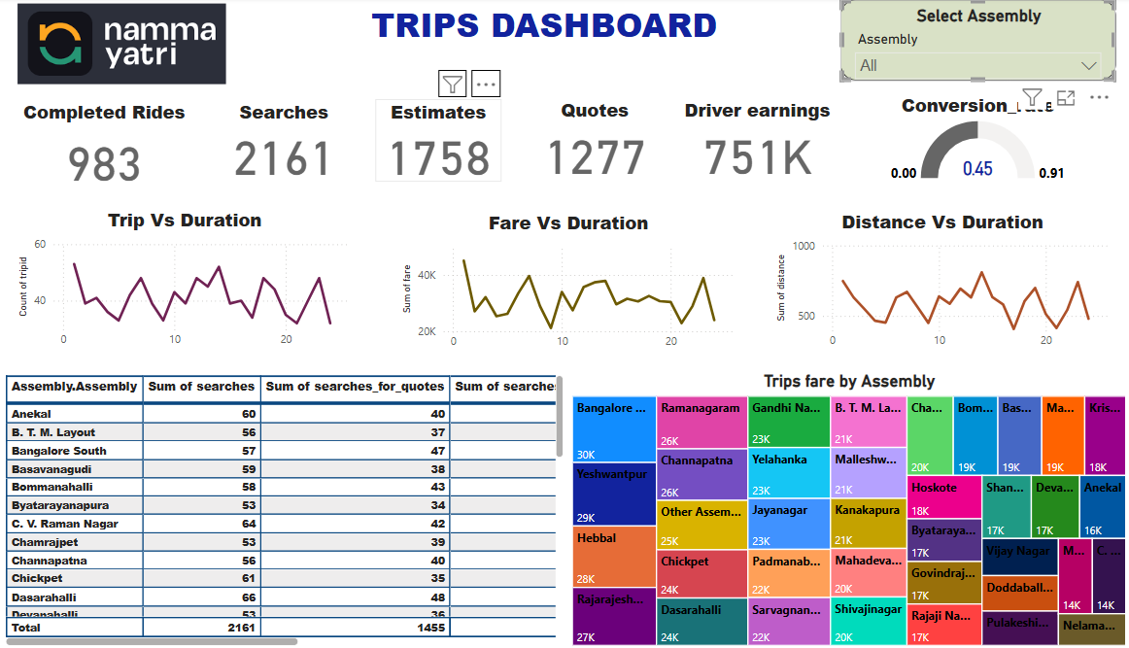

Slide 9
Expected Outcomes
15% increase in average daily earnings per driver
AI-driven fare optimization to balance affordability & revenue.
Improved customer satisfaction and retention
Increased digital payment adoption through targeted incentives.
Improved driver performance through better data-driven allocation.

Slide 10
Conclusion
Data-driven insights help optimize ride-hailing operations.
Reducing cancellations & improving pricing can boost customer retention.
Smart allocation of drivers increases efficiency & service quality.
Digital transformation strategies will enhance financial performance.

